Slide 1
Welcome!
Excess Soil Management in the Town of East Gwillimbury
Proposed Updates to the Fill and Site Alteration By-law
Public Information Centre
October 22, 2025
Your comments are encouraged and appreciated, as this will
provide us an opportunity to address concerns.

Slide 2
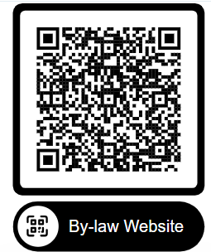
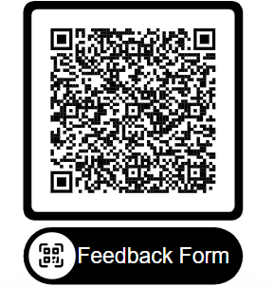
Need for Site Alteration By-law Update
The Town has had a Fill Bylaw in place since 2006 which has successfully managed the placement of over 2 million cubic meters of fill safely and in accordance with provincial regulations. There are currently 2 large commercial fill operations in Town which have extensive Fill Management Plans with ongoing testing at the source site, at the fill site and including monitoring wells at the source site to ensure quality.
Significant regulatory and legal precedent changes since the By-law was first prepared and amended. Current Fill By-law #2013-066 was last amended in 2018 by Amending By-law #2018-099.
Changes to the Municipal Act related to authority over Conservation Authority Lands.
Ontario Regulation 406/19 Onsite and Excess Soil Management introduced with amendments.
Ministry of Natural Resources have amended Regulations to allow filling operations under Aggregate Licenses.
Need for Site Alteration By-law Update

Slide 3
Need for Site Alteration By-law
Sources of Excess Soil
Approximately 25,000,000 m³ of excess soil is generated in the GTA annually. This is approximately 2,500,000 triaxle dump truck loads,
The majority is generated from development projects such as subways, condominiums, subdivisions and pipelines,
The majority is clean natural soil.
Provincial Policy for Beneficial Reuse and Recycling
Excess soil is a resource that must be reused for beneficial purposes,
The Resource Productivity and Recovery Authority (RPRA) is the regulator mandated by the Province of Ontario to enforce the Province’s circular economy laws. It maintains a registry of the generation, movement and deposition of excess soil.
Receiving Sites for Excess Soil
Urban intensification means excess soil must be shipped out of the GTA,
Landfill sites are nearing capacity and excess soil will be banned from landfills in 2027,
Receiving sites are required for the beneficial reuse of excess soil.
East Gwillimbury focused Excess Soil Management Strategy
An updated Site Alteration and Fill By-law is proposed to be supported by a By-law Guideline. The By-law is being prepared in alignment with provincial laws and regulations including the Town’s authority as outlined in the Municipal Act. The By-law Guideline will provide details on technical standards outlining how proposed backfilling with Excess Soil at a site is studied, engineered and controlled through a By-law Permit with Conditions. The By-law and the By-law Guideline will be aligned with Ontario Regulation 406/19 Onsite and Excess Soil Management and both government and industry Best Management Practices.
Excess Soil Management in the Town of East Gwillimbury

Slide 4
Proposed By-law Highlights
Revised By-law Highlights
The proposed By-law update prioritizes environmental protection and refinement of definitions:
Ensuring alignment with applicable Provincial Regulations.
Provide requirements specifically for Liquid Soil and Hydro-vac trucks (current by-law doesn’t speak specifically to Liquid Soil):
Environmental concerns are the primary driver for the requirements
Applicants have expressed interest in creating a safe processing site for these trucks.
Introduction of the Minor Site Alteration Permit:
This will include all activity on a property outside of topdressing a lawn
Intent is to reduce drainage issues with neighbours, increase homeowner awareness of drainage considerations
Free online questionnaire to apply and receive permit.

Slide 5
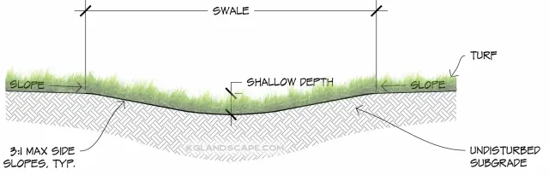
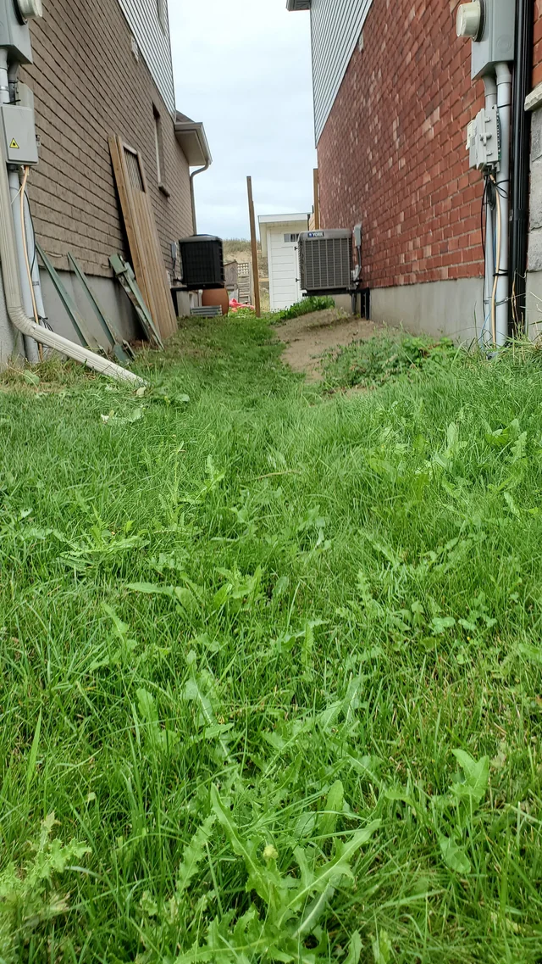
Minor Permit and Online Questionnaire
Minor Permit and Online Questionnaire
All activity beyond Lawn Dressing will require a permit. This will help avoid
drainage issues between neighbours. Typical issues involve filling or
blocking drainage swales.
Permit application entails an online questionnaire (yes/no questions);
Permit will be issued/emailed to the applicant, provided the project
poses low risk to surrounding properties.
Email will be sent to the applicant, to contact Engineering, if their project poses a concern.

Slide 6
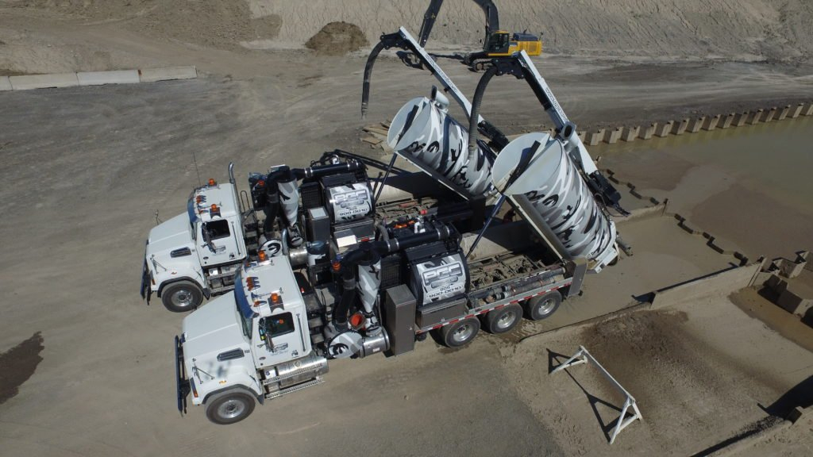
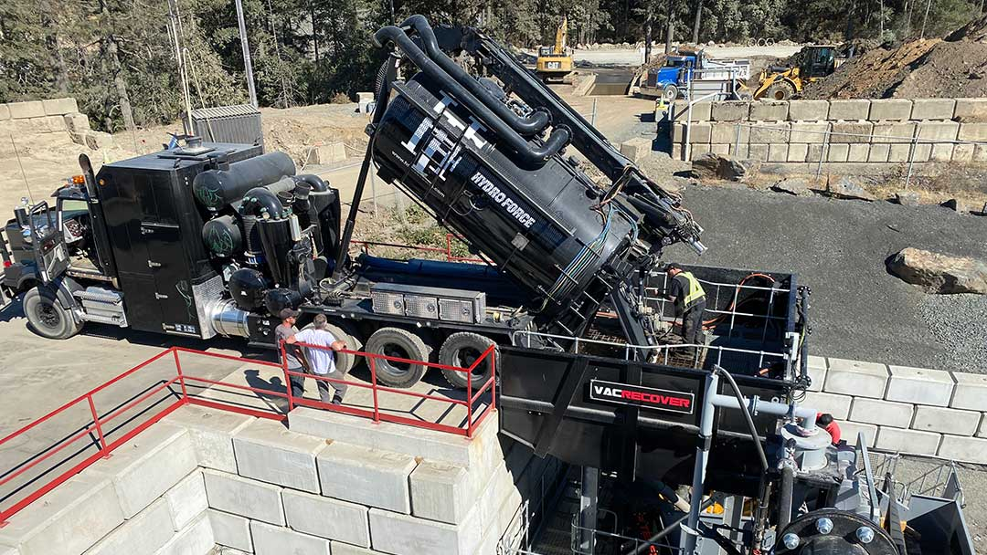
Liquid Soil (Wet Fill)
Through the process of updating the Town’s Site Alteration and Fill By-law (2013-066, Amended in 2018) questions have been posed as to how the Town will manage “wet fill”.
Other Municipalities in Ontario have been successfully processing wet fill safely for some time, and our proposed by-law intends to provide guidance for sites to accept wet soil provided they also meet stringent best management practices in accordance with provincial regulations. The details of the operation would be outlined in the site’s Fill Management Plan (FMP) as part of the approval process and would be managed for compliance with the FMP by the Town and our environmental consultant, referred to as our Qualified Person (QP).
What is “wet fill”?
In simple terms, “wet fill” or “wet soil” is the same as dry soil except that it is mixed with clean water to form a slurry. Provincial Regulations use the term Liquid Soil to describe this slurry. The following slide describes relevant definitions and regulations that apply to Liquid Soil.
Liquid Soils (Wet Fill)

Slide 7
Background Information on Liquid Soil (Wet Fill)
Ontario Regulation 406/19
There is no regulatory term for “wet fill” however there is a definition for Liquid Soil in Ontario Regulation 406/19 Onsite and Excess Soil Management.
Based on Ontario Regulation 153/04 Liquid Excess Soil can be beneficially reused on sites within Town jurisdiction with specified controls and restrictions.
Ontario Regulation 347
Transportation management and disposal of liquid waste must be in accordance with Ontario Regulation 347. All waste receiving and disposal sites are required to have an ECA issued by the MECP.
Waste Management as per O. Reg. 347 is excluded Site Alteration and Fill By-law.
Sources of Liquid Excess Soil
Liquid Excess Soil (“wet fill”) that is defined by Ontario Regulation 406/19 and mentioned in the Town By-law is predominately water saturated excess soil derived from such sources as vac trucks, tunnel and micro tunnel boring slurry, and geothermal drilling slurry.
Vac trucks are specialized vehicles that use vacuum suction to excavate soil usually from places where conventional extraction is not practical. They use high pressure clean water from an on-board tank to help break up the soil and enhance vacuuming.
The chemical quality of the liquid soil reflects the chemical quality of the dry soil.
The use of Liquid Excess Soil as Fill
As noted above, the beneficial reuse of Excess Soil (both dry and liquid) is outlined in Ontario Regulation 406/19 and encouraged by Provincial policy for reuse and recycling.
The proposed Town By-law and supporting Guidelines Manual outlines the requirements for any application for the beneficial reuse of dry excess soil as fill as well as liquid excess soil as fill.
In the case of any application for the beneficial reuse of excess liquid soil for filling, the By-law requires Public Consultation and Council approval.

Slide 8
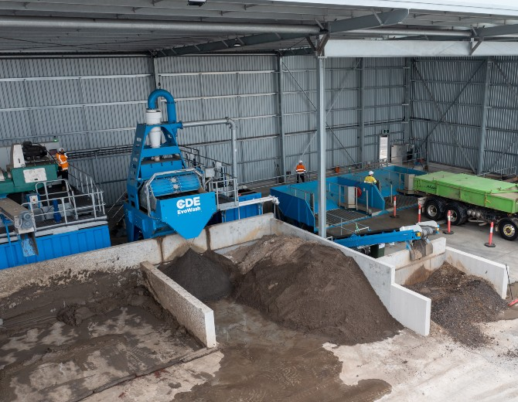
Liquid Soil Receiving Sites
There are different methods used across Ontario to manage Excess Liquid Soil. Some facilities are completely indoors and utilize centrifuges, presses, and other mechanical means to separate the soil and water. Other methods may include the addition
of environmentally benign solidifying agents to create a
dry soil.
Other facilities typically outdoors have a concrete receiving
basin to contain the liquid soil for inspection and sampling.
Upon receipt of the sampling results, the soil and liquid
components would be shipped to an approved receiving
site.
Applicants will be required to provide a Fill Management
Plan which will detail their acceptance protocol for the
Hydro Vac liquid soil. This will be reviewed by the Town and their Peer Review consultant to ensure compliance with MECP Standards.
Once all comments, questions, and concerns are addressed, the applicant will be required to host a Public Information Meeting and seek approval from Council.
Liquid Soils Receiving Sites

Slide 9
Regulations
Laws
Environmental Protection Act. R.S.O.1990, c E.19
Regulations
Ontario Regulation 406/19, On-Site and Excess Soil Management made under the Environmental Protection Act, December 4, 2019, as amended. For the management of excess soil in alignment with other regulations including Ontario Regulation 153/04 and Ontario Regulation 347.
Referenced by Regulation
Rules for Soil Management and Excess Soil Quality Standards, Ministry of Environment Conservation and Parks (MECP), February 2024. Referenced in Ontario Regulation 406/19. Provides a set of soil quality tables for various land uses and site conditions and outlines the use of the Beneficial Reuse Assessment Tool (BRAT) and Risk Assessment.
MECP Best Management Practices and Supporting Documents
Management of Excess Soil – A Guide for Best Management Practices (BMP), MECP, January 2014. Sets out expectations for all those managing soil and encourages the beneficial reuse of excess soil in a manner that promotes sustainability and the protection of the environment.
The Excess Soil Policy Framework, MECP, December 2016. Outlines the management of excess soil in a responsible way that is integral to building sustainable communities.
Rationale Document for Development of Excess Soil Quality Standards, MECP, November 19, 2019. Provides the scientific derivation process to develop the Excess Soil Quality Standards.
Federal Guidelines
Excess Soil Reuse Guidance, The Canadian Council of Ministers of the Environment (CCME), 2025. Highlights the beneficial reuse of excess soil.
Industry Best Management Practices and Supporting Documents
Scientific Report, Beneficial Reuse of Excess Soil at Aggregate Pits and Quarries, Ontario Society of Professional Engineers, March 2021.
Best Management Practices for Aggregate Pit and Quarry Rehabilitation in Ontario, Ontario Society of Professional Engineers, March 2021.

Slide 10


Next Steps
Public Consultation
PIC commenting window is open for a 30-day period. Comment submission deadline is November 22, 2025.
Receive PIC feedback, review, and update the By-law as required.
Implementation
Staff will prepare an information memo for Council on the proposed By-law update including any updates based on feedback from the PIC in Q4 2025. Staff propose to return to Council in early 2026 with the Final proposed By Law for their consideration in Q1-2026.
Thank you
For participating in this PIC

Slide 11
We Want to Hear From You!
We Want to Hear From You!
For more information on the By-law update, please follow the QR code above.
To provide feedback, please follow the QR code above.

Slide 12


